Slide 1
2018 GMHA Anticoagulation for Healthcare Professionals: Clinical Pearls & Updates
Guam memorial hospital 4th floor classroom ON Nov. 13 – 14, 2018
Presented By: Margaret Kang, Pharm.D., CACP and Jamie Lee, Pharm.D., CACP

Slide 2
Objectives
Review Virchow’s Triad and the Clotting Cascade Pathway
Discuss the different anti-thrombotic medications available at GMH
Identify ways to improve anticoagulation monitoring and documentation
Review clinical pearls of warfarin management
Review clinical pearls of direct oral anticoagulants (DOAC)
Discuss the different types of anticoagulation reversals available at GMH
Highlight the new changes and updates in the heparin infusion protocol
Review of medications used in Heparin-Induced-Thrombocytopenia (HIT)
Recognize the importance of anticoagulants as high alert medications

Slide 3
Virchow’s Triad

Slide 4
Coagulation (Clotting) Cascade

Slide 5
GMHA – Antithrombotic Agents
 | Warfarin | Enoxaparin | Heparin | Fondaparinux | Argatroban | Alteplase | Tenecteplase
Brand | Coumadin | Lovenox | - | Arixtra | - | Cathflo or TPA | TNKase or TNK
Route | PO | SQ or IV | SQ or IV | SQ or IV | IV | IV or IA | IV
MOA | Vitamin K antagonist | Indirect Thrombin Inhibitor (Xa) |  | Factor Xa Inhibitor | Direct Thrombin Inhibitor | Thrombolytic (Fibrinolysis)
Half-Life | 20 - 60 hrs | 4.5 - 7 hrs | Mean: 1.5 hrs | 17 - 21 hrs | 39 - 51 mins (Hepatic impaired: 180 mins) | 5 mins | Biphasic: 20 - 24 mins then 90 - 130 mins
Duration | 5 - 7 days | ~12 hrs | n/a | n/a | n/a | 1 - 2 hrs | n/a

Slide 6
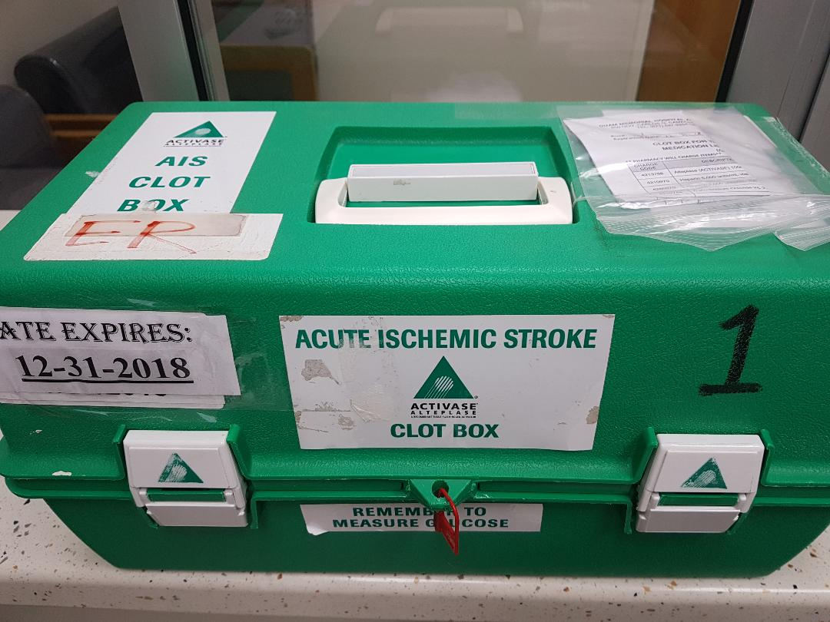
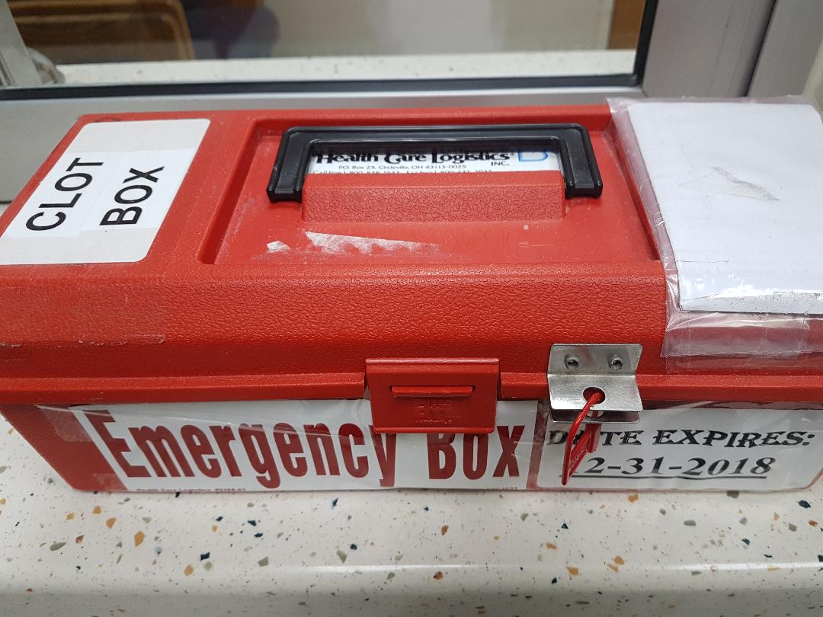
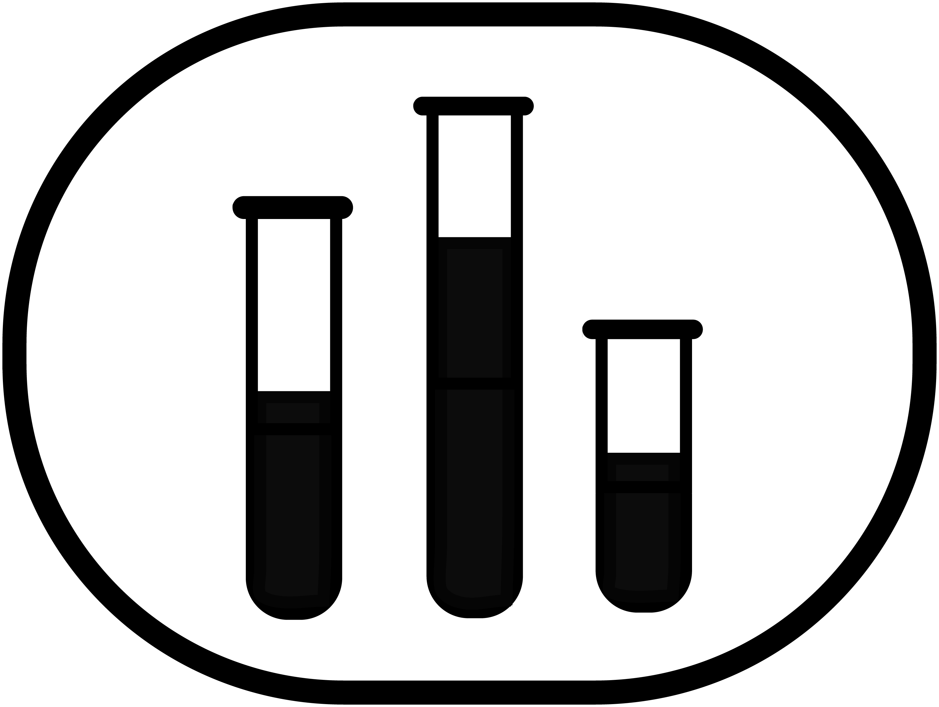
GMHA – Antithrombotic Agents
 | Warfarin | Enoxaparin | Heparin | Fondaparinux | Argatroban | Alteplase | Tenecteplase
Brand | Coumadin | Lovenox | - | Arixtra | - | Cathflo or TPA | TNKase or TNK
Route | PO | SQ or IV | SQ or IV | SQ or IV | IV | IV or IA | IV
Dx Indication | AFIB, VTE tx, ppx, Valves, MI reduction | ACS (NSTEMI/STEMI), AFIB, PCI, VTE (DVT/PE) tx, ppx, bridge |  | ACS, VTE (DVT/PE) tx, ppx, bridge, SVT, HIT | HIT, PCI | Ischemic Stroke, PE, STEMI, arterial occlusion | STEMI, PE
 | H/H, PLT PTT, PT/INR | H/H, PLT PT/INR, SCr, (anti-Xa) | H/H, PLT, PTT, PT/INR | H/H, PLT, SCr | H/H, PLT, PTT, PT/INR, AST/ALT | CT, Neuro, BP, CBC, PTT, PT/INR, Glucose | CBC, PTT, PT/INR, EKG

Slide 7
GMHA – Antithrombotic Agents
 | Warfarin | Enoxaparin | Heparin | Fondaparinux | Argatroban | Alteplase | Tenecteplase
Brand | Coumadin | Lovenox | - | Arixtra | - | Cathflo or TPA | TNKase or TNK
CI contra-indication | Major Bleeding | Major Bleeding, HIT, Severe Thrombocytopenia, True Pork Allergy |  | Major Bleeding, CrCL < 30ml/min | Major Bleeding | Major Bleed, INR ≥ 1.7, HTN Crisis, Recent Sx | Major Bleed, HTN crisis, Recent Sx
 | Category X | Category B | Category C | Limited/ Unknown | Limited/ Unknown | Category C

Slide 8
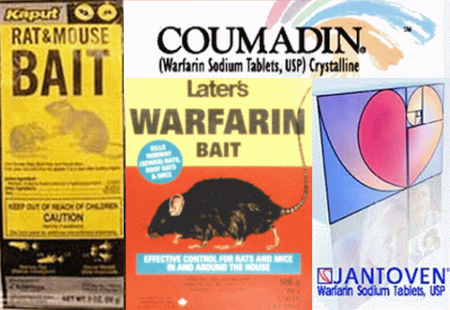
Warfarin (Coumadin)

Slide 9
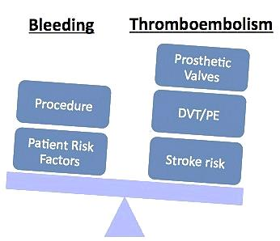
Warfarin - Indications

Slide 10
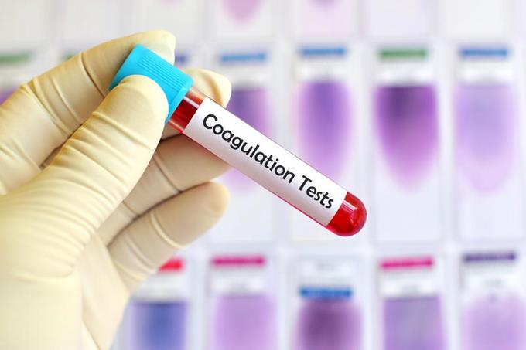
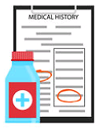
Clinical Pearls - Warfarin
Warfarin – Nurse/CNA Monitoring and Documentation
BEFORE starting warfarin
Order STAT Baseline INR and CBC (or Hemogram – WBC/Hgb/Hct/PLT)
Interview and Document Warfarin History
What is the home-med warfarin dose? Color of the pill?
When was warfarin last taken? - Avoid double dosing
Obtain outpatient pharmacy info if history unknown

Slide 11
Clinical Pearls - Warfarin
Warfarin – Nurse/CNA Monitoring and Documentation
BEFORE starting warfarin
Assess and document
Any s/s of bleeding or clotting
N/V/D or Constipation
Dietary or Appetite Changes
Pending Procedures – What type of procedure and When?

Slide 12
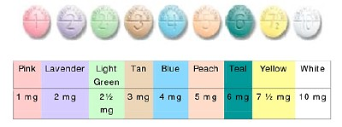
Clinical Pearls - Warfarin
Warfarin – Nurse/CNA Monitoring and Documentation
Warfarin Dose (mg) Given/Refused
Document what dose (mg) was administered
If patient refused, please document
Notify MD/pharmacist
GMHA Warfarin Dosing Time
Frequency: QDCOUM (iMED) = Daily at 1800
Unless otherwise indicated by Physician

Slide 13
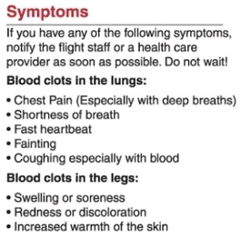
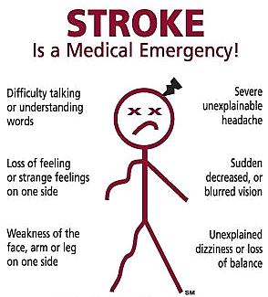
Clinical Pearls - Warfarin
Warfarin – Nurse/CNA Monitoring and Documentation
Document Signs & Symptoms of Bleeding/Bruising/Clotting
Check daily labs if available (H/H/PLT, INR)
Use colorful, descriptive words, measurements (size)
If there is no bleeding or clotting observed, document it!
Notify MD if patient has bleeding or clotting symptoms
Always think in trends!
worsening, getting better, same condition

Slide 14
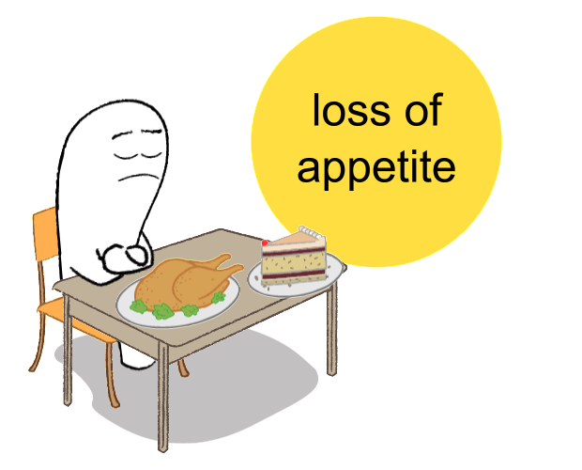
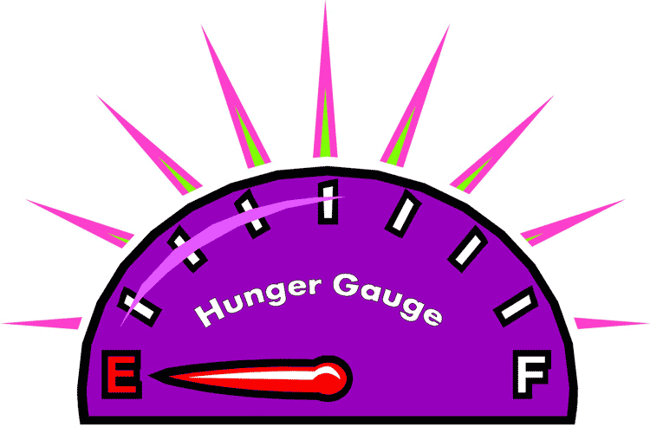
Clinical Pearls - Warfarin
Warfarin – Nurse/CNA Monitoring and Documentation
Appetite
Intake of vitamin K through diet affects INR levels
Always think in trends!
Increasing, decreasing, same appetite
% of meal (breakfast/lunch/dinner) consumed
Outside food or any vegetables/fruits consumed
Ex: Green tea, Prune Juice, Mangos, Grapefruits

Slide 15
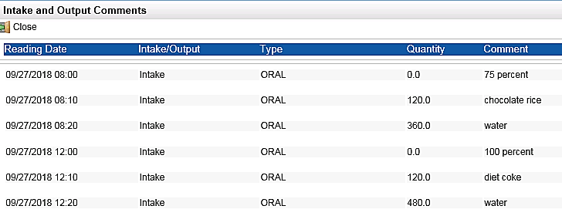
Clinical Pearls - Warfarin
Warfarin – Nurse/CNA Monitoring and Documentation
Appetite

Slide 16
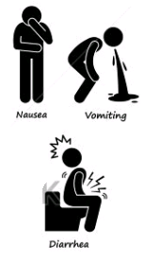
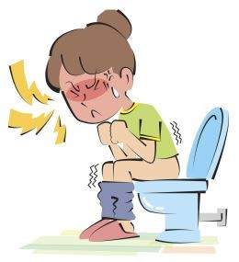
Clinical Pearls - Warfarin
Loss of Vitamin K
Warfarin – Nurse/CNA Monitoring and Documentation
Nausea, Vomiting, Diarrhea (N/V/D) & Constipation
Loss of Vitamin K through N/V/D will increase INR levels
Increased Vitamin K through constipation decreases INR
Use “colorful” descriptive words
Black, Tarry, Bright Red, Light Green, Tea-colored
Quantify amount - Small, Moderate, Large or units (mL)
Indicate even when conditions are “NORMAL”
No NVD, No Constipation
Normal BM, Normal Void
Increased Vitamin K (Constipation)

Slide 17
Clinical Pearls - Warfarin
Warfarin – Nurse/CNA Monitoring and Documentation

Slide 18
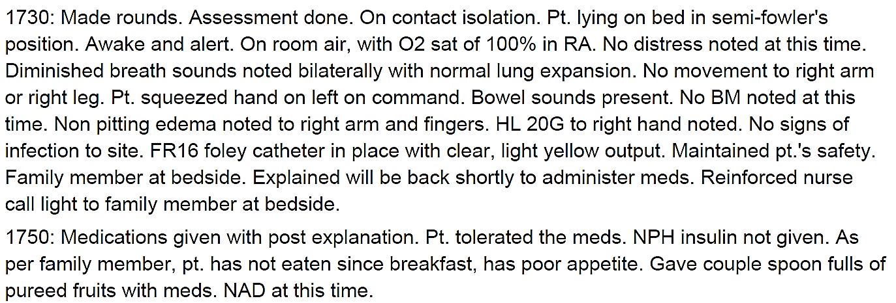
Clinical Pearls - Warfarin
Warfarin – Nurse/CNA Monitoring and Documentation

Slide 19
Clinical Pearls - Warfarin
Warfarin – Nurse/CNA Monitoring and Documentation

Slide 20
Clinical Pearls - Warfarin
Warfarin – Nurse/CNA Monitoring and Documentation
Uncontrolled Pain/Fever
Increase INR levels
Changes in Medications
Decrease INR levels
Ex: Barbiturates, Carbamazepine, Nafcillin, Phenytoin, Rifampin
Increase INR levels
Ex: Amiodarone, Antibiotics (Bactrim, Flagyl, FQs, Macrolides), Antifungals (-azoles), Phenytoin, Steroids

Slide 21
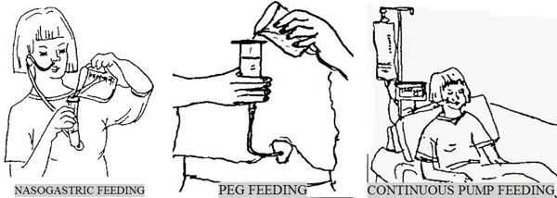
Clinical Pearls - Warfarin
Warfarin – Nurse/CNA Monitoring and Documentation
Separate Sucralfate and Warfarin
Administer warfarin 2 hours before or 6 hours after sucralfate due to decreased absorption
PEG/NG Tubefeed(TF)
Hold TF at least 1 hour before and after any warfarin administration to maximize absorption
Note TF Hold on the MAR

Slide 22
Clinical Pearls - Warfarin
Warfarin – Nurse/CNA Monitoring and Documentation
-----------

Slide 23
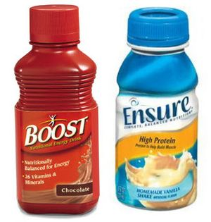
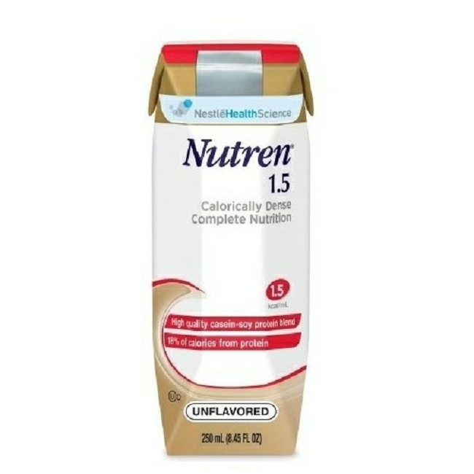
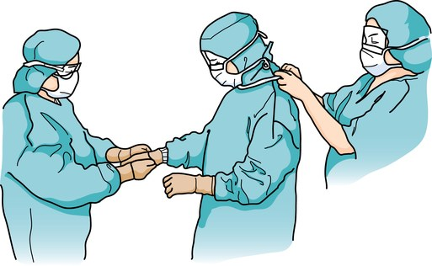
Clinical Pearls - Warfarin
Warfarin – Nurse/CNA Monitoring and Documentation
Document liquid nutritional supplements
Ex: Boost, Ensure, Glucerna, Jevity, Nepro, Novasource, Nutren, Peptamen, etc.
Contains small, varying amounts of vitamin K
Document Detailed Planned Procedure
Careful planning of holding anticoagulants prior to procedures and restarting them after procedures can minimize bleeding/clotting risk
Be Proactive! Ask physicians about holding/restarting warfarin for procedures

Slide 24
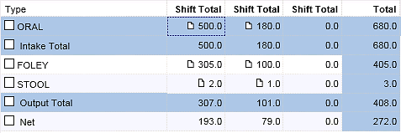
Clinical Pearls - Warfarin
Warfarin – Nurse/CNA Monitoring and Documentation
Ensure contains Vitamin K

Slide 25
Clinical Pearls - Warfarin
Warfarin – Nurse/CNA Monitoring and Documentation

Slide 26
Clinical Pearls - Warfarin
Warfarin – Nurse/CNA Monitoring and Documentation
Vitamin K is the reversal for warfarin Important to document any reversals given
Please add route (PO, IV, or SQ) and dose (mg)

Slide 27
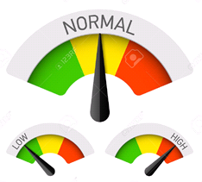
Clinical Pearls - Warfarin
Warfarin – Nurse/CNA Monitoring and Documentation
If patient is stable or normal, document it!
Normal BM, Normal Void
Negative for bleed, NVD, constipation
No s/s of active bleeding or clotting noted
Pharm-to-dose Warfarin
Warfarin currently “floor stocked” except for SNU
Pharmacist will review patient’s profile prior to sending dose
Verify warfarin dose a w/ Pharmacist before administering

Slide 28
Clinical Pearls - Warfarin
Warfarin – Nurse/CNA Monitoring and Documentation
Know therapeutic INR range = 2 – 3 (2.5 – 3.5 for mitral heart valves)
When reporting INR to anyone = Always think in trends!
Ex: Report previous day’s INR with current day INR level
Current INR 1.2 vs. INR 1.0 → 1.2
Current INR 1.9 vs. INR 1.0 → 1.9
Current INR 2.5 vs. INR 1.0 → 2.5
Current INR 0.9 vs. INR 1.0 → 0.9

Slide 29
Clinical Pearls - Warfarin
ANTICOAG - Nurse/CNA Monitoring and Documentation (Review)
A = Appetite trends
N = NVD - Nausea/Vomiting/Diarrhea
T = Temperature or Tubefeed
I = Inspect for bruising/bleeding/clotting symptoms
C = Constipation
O = Operation or procedures
A = Antibiotics or Amiodarone
G = Given (mg) or Not Given
Proper monitoring and documentation promotes patient safety and improves patient care
Notes:
HOLD orders --- LEVEL OF CARE

Slide 30
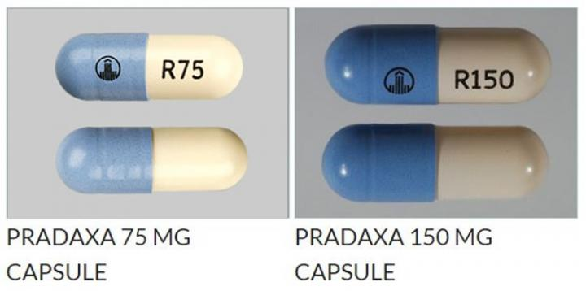
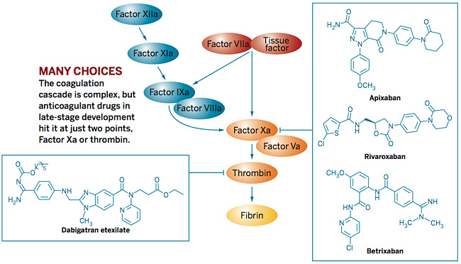
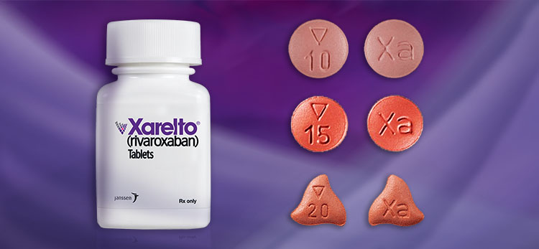
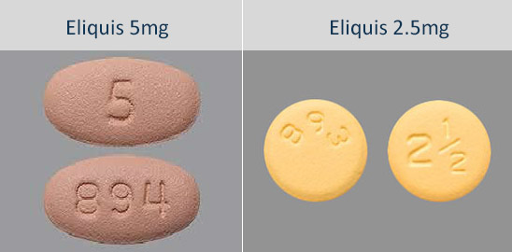
DOAC – Direct Oral Anticoagulants

Slide 31
Coagulation (Clotting) Cascade

Slide 32
DOAC - Pharmacological Properties

Slide 33
DOAC Indications
Reduction of stroke in non-valvular atrial fibrillation
Prevention of VTE following hip or knee replacement
Treatment and prevention of VTE

Slide 34
DOAC Dosing
Unlike Warfarin:
DOAC doses are fixed based upon patient factors, such as renal function, age, weight and indication
Dose frequency is either daily, or twice daily depending on indication
Q24H or Q12H frequency preferred for all anticoagulation

Slide 35
DOAC – Pradaxa (Non-formulary)
Dabigatran (Pradaxa)
Storage
Capsules must be stored in original bottle.
Discard 4 months after opening original bottle (unless it is an individual blister pack)
Store at room temperature.
Administration
Swallow whole. Do not chew, open, or crush.
Take with a full glass of water.

Slide 36
DOAC – Pradaxa (Non-formulary)
Dabigatran (Pradaxa)
Missed dose recommendation
Take a missed dose as soon as you think about it.
If < 6 hours until next dose, skip the missed dose and go back to the normal time.
Do not take 2 doses at the same time or extra doses.
If unable to obtain medication
Notify MD to obtain orders for alternative anticoagulation.
Call pharmacy for timing transition between different anticoagulants for optimal patient care.

Slide 37
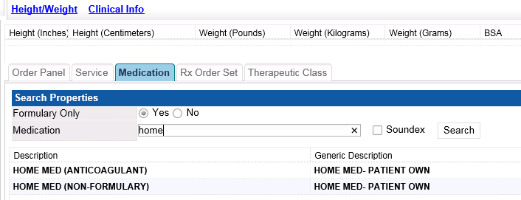
DOAC – Pradaxa (Non-formulary)
Use the Home Med (Anticoagulant) for Pradaxa or other non-formulary anticoagulants

Slide 38
DOAC – Xarelto
Rivaroxaban (Xarelto)
Storage
Store at room temperature.
Administration (QPM)
10mg Tablet
Take with or without food.
If patient cannot swallow tablets, may crush and mix with applesauce, and give within 4 hours.
Those who have feeding tubes may also crush 10mg tablets, mix with 50mL water, and give within 4 hours. Flush the feeding tube after.

Slide 39
DOAC – Xarelto
Rivaroxaban (Xarelto)
Administration (QPM)
15mg and 20mg Tablet
Take this medication with food.
If patient cannot swallow tablets, may crush and mix with applesauce, and give within 4 hours. Eat some food right after taking crushed tablet.
Those who have feeding tubes may also crush the 15 mg or 20 mg tablets, mix with 50 mL of water and give within 4 hours. Give enteral feeding right after giving dose.

Slide 40
DOAC – Xarelto
Rivaroxaban (Xarelto)
Missed dose recommendation
15mg PO Q12H – for DVT
Take missed dose right away to make sure you get 30 mg in one day.
You may take 2 tablets at the same time. Then go back to the normal times the next day.
All Other Dosing
Take a missed dose as soon as you think about it.
If it is close to the time for the next dose, skip the missed dose and go back to the normal time.
Do not take 2 doses at the same time or extra doses.
If unable to obtain medication
Notify MD to obtain orders for alternative anticoagulation
Call pharmacy for timing transition between different anticoagulants for optimal patient care

Slide 41
DOAC – Eliquis
Apixaban (Eliquis)
Storage
Store at room temperature.
Administration (Q12H)
Take with or without food.
If patient is having trouble swallowing, may crush tablet, mix with water, apple juice, or applesauce, and give within 4 hours.
Those who have feeding tubes may crush tablet, mix with 50mL water, and give within 4 hours. Flush the feeding tube after.

Slide 42
DOAC – Eliquis
Apixaban (Eliquis)
Missed dose recommendation
Take a missed dose as soon as you think about it
If it is close to the time of the next dose, skip the missed dose and go back to the normal time.
Do not take 2 doses at the same time or extra doses.
If unable to obtain medication
Notify MD to obtain orders for alternative anticoagulation
Call pharmacy for timing transition between different anticoagulants for optimal patient care

Slide 43
DOAC – Adverse Effects
 | Dabigatran | Rivaroxaban | Apixaban
Common | Bleeding Bruising Nausea Dyspepsia Gastritis Abdominal pain | Bleeding Bruising Dyspepsia | Bleeding Bruising Nausea

Slide 44
DOAC – Pregnancy & Lactation
 | Dabigatran | Rivaroxaban | Apixaban
Brand | Pradaxa | Xarelto | Eliquis
 | Category C | Category C | Category B
 | Unknown if excreted in milk, D/C breastfeeding or drug

Slide 45
DOAC – Monitoring
Unlike Warfarin:
There is no need to routinely measure patient blood levels and make dose adjustments according to a ‘therapeutic range’
However:
DOACs are excreted renally. Renal function should be monitored
Patients should also be routinely assessed for signs of bleeding and for other bleeding risk factors (e.g. other medicines; platelet counts)

Slide 46
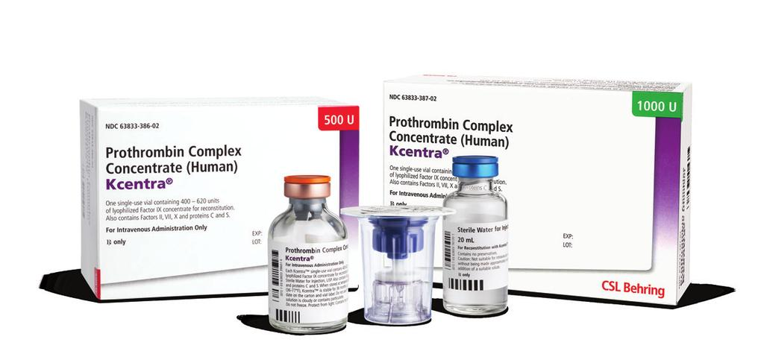
DOAC – Reversal Management
Activated charcoal
Apixaban - within 6 hours
Dabigatran - within 2 - 4 hours
Rivaroxaban - within 2 hours
Kcentra - Preferred
Factor VIIa (NovoSeven)
Dialysis - only for Dabigatran

Slide 47
Clinical Pearls – DOACs
Direct Oral Anticoagulants (DOACs)
Do Not Miss Doses!
Short-acting → Increases risk for Stroke/VTE
Obtain Refills in a Timely Manner
Alert patient or family member to bring refills
If Dose is Missed
Document and Notify Physician or Pharmacist for next plan of action

Slide 48
Clinical Pearls – DOACs
Direct Oral Anticoagulants (DOACs)
Document Detailed Planned Procedures
Be Proactive! Ask Physicians regarding holding and restarting of DOACs
Recommend to write “Anticoagulant” or “Anticoag” on PAPER MAR
ALERT nurses to assess and document for s/s of bleeding/ bruising/clotting
ALERT nurses to plan ahead for refills to avoid missed doses
ALERT nurses to ask Physicians to plan for procedures

Slide 49
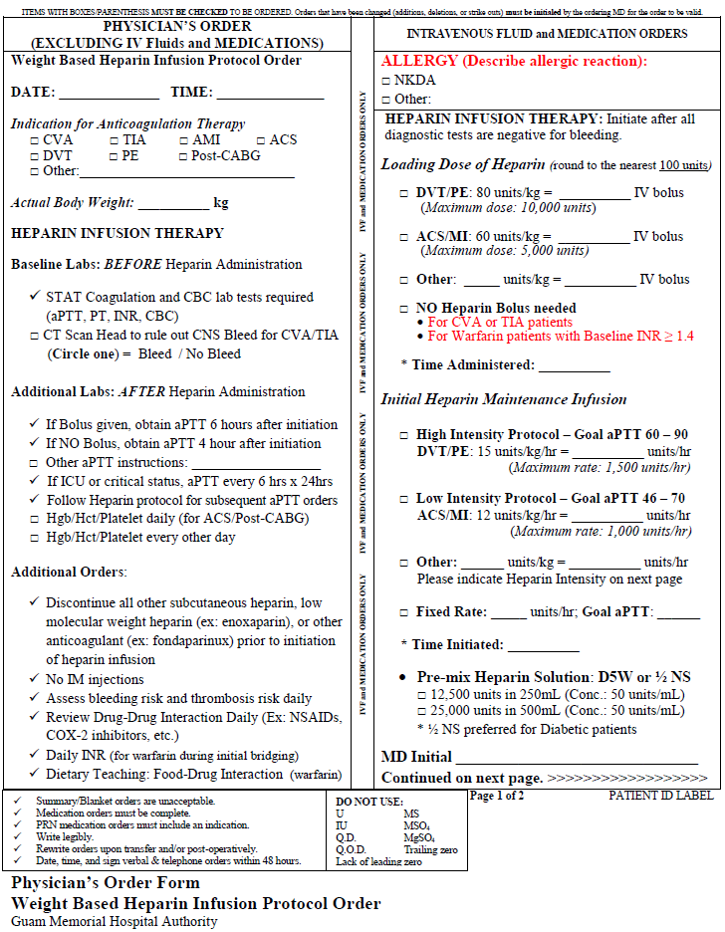
Clinical Pearls – Heparin Drip Update
Heparin Drip Update
STAT Initial Coagulation and CBC Labs for all patients
Additional Labs (w/bolus, without bolus, ICU/Critical status)
Additional Orders
Loading dose of Heparin Bolus with Maximum Dosing
Initial Maintenance Infusion with Maximum Rate
Different Heparin Intensity – ACS/MI vs. DVT/PE

Slide 50
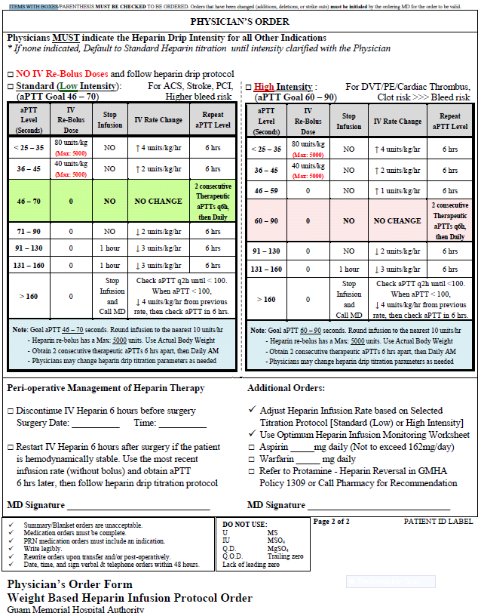
Clinical Pearls – Heparin Drip Update
Heparin Drip Update
Physicians Must Indicate Heparin Drip Intensity
NO IV Re-Bolus section for heparin drip protocol
Standard (Low Intensity) – Previous Heparin Drip Protocol
High Intensity Heparin Drip Protocol
Note: Different aPTT Goals based on Indications
2 consecutive THERAPEUTIC aPTTs before daily aPTT
Maximum dose for Re-Bolus: Heparin 5000units IV.

Slide 51
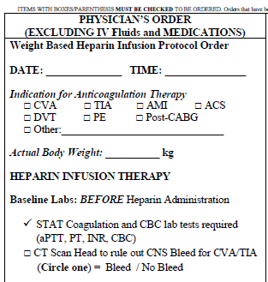
Clinical Pearls – Heparin Drip Update
Check Indication
Use Actual Body Weight
STAT Baseline Labs is MUST!
CT Scan Head to rule out CNS Bleed
If Yes to Bleed – Notify MD right away
Ask about discontinuing heparin drip
IF patient received Alteplase for Stroke
Heparin drip is generally started 24 hours AFTER
Recommend to verify with Physician

Slide 52
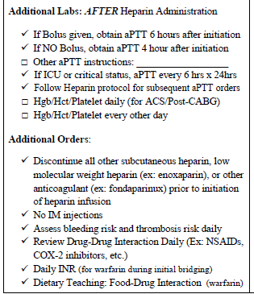
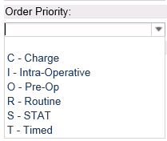
Clinical Pearls – Heparin Drip Update
Additional Labs
If Bolus given – next aPTT is in 6 hours
If NO Bolus – next aPTT is in 4 hours
If ICU or critical status, aPTT every 6 hrs for 24 hrs
MUST order labs as “STAT” or “TIMED”
Additional Orders
Discontinue all other SQ anticoagulants: Heparin, LMWH, Fondaparinux
No IM Injections

Slide 53
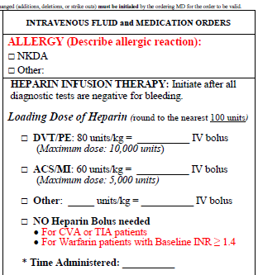
Clinical Pearls – Heparin Drip Update
Loading Dose of Heparin
Route: IV bolus
Different Bolus by Indication
Maximum loading doses
DVT/PE: 10,000 units IV
ACS/MI: 5000 units IV
No Bolus for CVA/TIA or INR ≥ 1.4
Physicians may order NO Bolus
Ask and Clarify with MDs

Slide 54
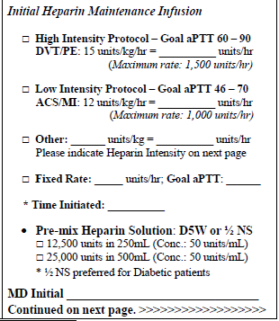
Clinical Pearls – Heparin Drip Update
Initial Heparin Maintenance Infusion
High Intensity = Higher aPTT Goal 60 – 90
Indication: DVT/PE
Maximum Initial Rate: 1500units/hr
Low Intensity = Standard aPTT Goal 46 – 70
Indication: ACS/MI
Maximum Initial Rate: 1000units/hr
Pre-Mix Solution = Concentration 50units/mL
D5W and ½ NS (preferred for Diabetic patients)

Slide 55
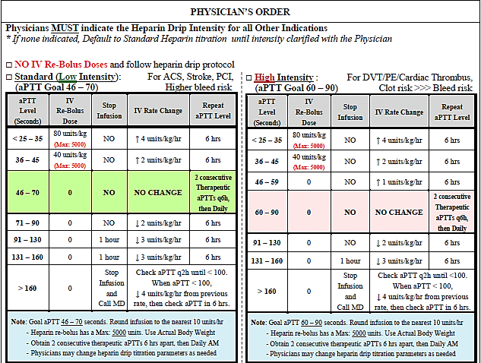
Clinical Pearls – Heparin Drip Update

Slide 56
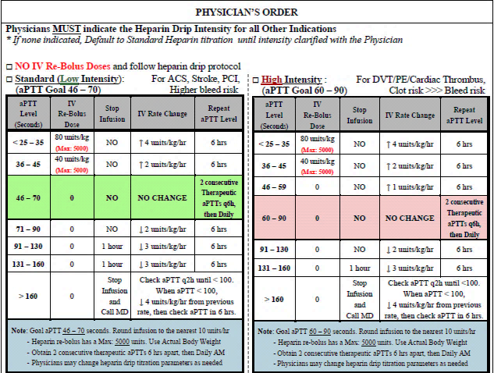
Clinical Pearls – Heparin Drip Update

Slide 57
Clinical Pearls – Heparin Drip Update
Physicians may always make changes to heparin drip orders

Slide 58
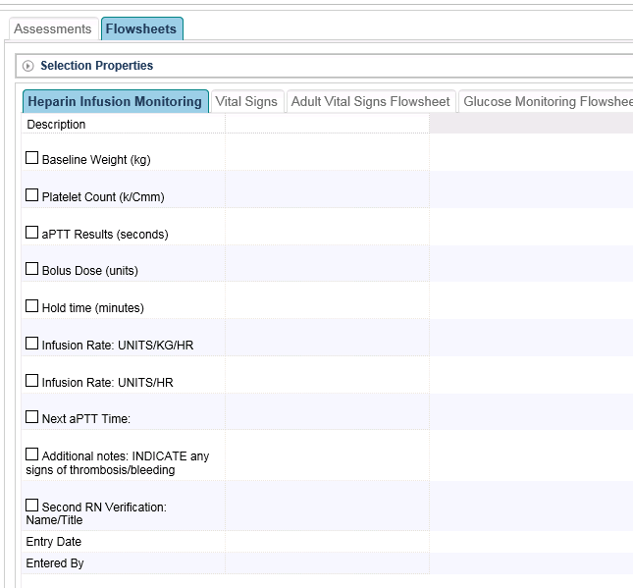
Clinical Pearls – Heparin Drip Update
Documentation of Heparin Infusion Monitoring is Mandatory
Use the Heparin Infusion Monitoring tab in the Assessment/Flowsheet section of the Optimum for all heparin drips
National Patient Safety Goal and JCAHO Requirement

Slide 59
Clinical Pearls – Heparin Drip Update
Overall goal is to improve turn around time for initiation and titration for Heparin drips.
Current turn around time
1.5 to 3 hours
Goal turn around time
Within 1 hour
Improve patient care
Minimize further clot or bleed risk
STAT or Timed order of aPTT levels are vital
Checking aPTT promptly is a high priority
Traceable Heparin Monitoring Infusion
Update medication status in real time
Hold, D/C, and Restart in iMED/Optimum AND paper MAR
Be careful during Level of Care
Obtain clear orders for Heparin drips
Transitioning anticoagulants
Ask Pharmacy

Slide 60
Clinical Pearls – HIT (Heparin Induced Thrombocytopenia)
HIT Criteria
Thrombocytopenia (ie, drop of >50% from the patient’s baseline)
Exclusion of other causes of thrombocytopenia (such as cancer, sepsis or chemotherapy)
Resolution of thrombocytopenia after cessation of heparin
Key interventions:
Prompt cessation of all heparin or LMWH (enoxaparin)
Initiation of an alternative anticoagulant at a therapeutic dose
Document HIT in medical record (update allergy)

Slide 61
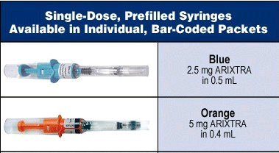
Clinical Pearls – HIT: Fondaparinux
Long half-life allows once-daily dosing
In pregnant women with HIT
In normal renal function
Contraindicated in CrCl <30 ml/min
Easier than Argatroban to use outside the intensive care unit

Slide 62
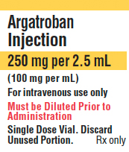
Clinical Pearls – HIT: Argatroban
IV continuous infusion
STAT Baseline aPTT and PT/INR, LFTs
Typical initial dose: 2mcg/kg/min
Dependent on LIVER function
Monitored using the activated partial thromboplastin time (aPTT)
Preferred in patients with impaired renal function

Slide 63
Anticoagulants – High Alert Medication
ISMP = Institute for Safe Medication Practices
Anticoagulants are considered high alert medications in the ISMP list which have a heightened risk of causing significant patient harm when used in error
Please monitor and document administration of all anticoagulants in patient notes

